Slide 1
Matrix multiplication

Slide 2
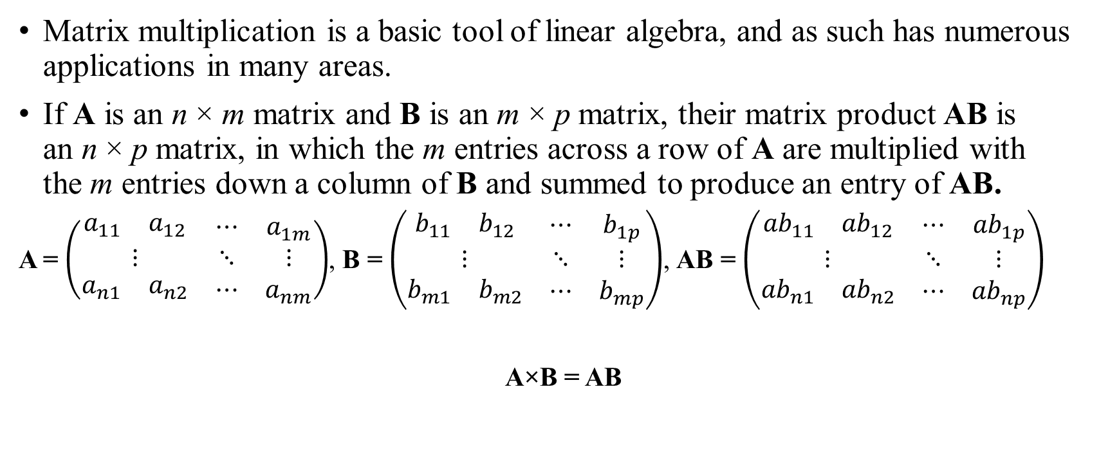
Matrix multiplication
Matrix multiplication is a basic tool of linear algebra, and as such has numerous applications in many areas.
If A is an n × m matrix and B is an m × p matrix, their matrix product AB is an n × p matrix, in which the m entries across a row of A are multiplied with the m entries down a column of B and summed to produce an entry of AB.
A = $\left(\begin{matrix}\begin{matrix}a_{11} & a_{12}\end{matrix} & ⋯ & a_{1m} \\ ⋮ & ⋱ & ⋮ \\ \begin{matrix}a_{n1} & a_{n2}\end{matrix} & ⋯ & a_{nm}\end{matrix}\right)$, B = $\left(\begin{matrix}\begin{matrix}b_{11} & b_{12}\end{matrix} & ⋯ & b_{1p} \\ ⋮ & ⋱ & ⋮ \\ \begin{matrix}b_{m1} & b_{m2}\end{matrix} & ⋯ & b_{mp}\end{matrix}\right)$, AB = $\left(\begin{matrix}\begin{matrix}{ab}_{11} & {ab}_{12}\end{matrix} & ⋯ & {ab}_{1p} \\ ⋮ & ⋱ & ⋮ \\ \begin{matrix}{ab}_{n1} & {ab}_{n2}\end{matrix} & ⋯ & {ab}_{np}\end{matrix}\right)$
A×B = AB

Slide 3

Matrix multiplication
So given 2 matrices, need to compute their multiplication.
Example:
$\left(\begin{matrix}\begin{matrix}1 & 3\end{matrix} & 2 \\ \begin{matrix}1 & 2\end{matrix} & 4\end{matrix}\right)$ × $\left(\begin{matrix}\begin{matrix}\begin{matrix}3 \\ 4\end{matrix} & \begin{matrix}1 \\ 2\end{matrix}\end{matrix} & \begin{matrix}1 \\ 5\end{matrix} \\ \begin{matrix}4 & 2\end{matrix} & 2\end{matrix}\right)$ = $\left(\begin{matrix}\begin{matrix}x & x\end{matrix} & x \\ \begin{matrix}x & x\end{matrix} & x\end{matrix}\right)$
${AB}_{11}$= $A_{11}∙B_{11}+A_{12}∙B_{21}+A_{13}∙B_{31}=1∙3+3∙4+2∙4=$ 23

Slide 4

Matrix multiplication
So given 2 matrices, need to compute their multiplication.
Example:
$\left(\begin{matrix}\begin{matrix}1 & 3\end{matrix} & 2 \\ \begin{matrix}1 & 2\end{matrix} & 4\end{matrix}\right)$ × $\left(\begin{matrix}\begin{matrix}\begin{matrix}3 \\ 4\end{matrix} & \begin{matrix}1 \\ 2\end{matrix}\end{matrix} & \begin{matrix}1 \\ 5\end{matrix} \\ \begin{matrix}4 & 2\end{matrix} & 2\end{matrix}\right)$ = $\left(\begin{matrix}\begin{matrix}23 & x\end{matrix} & x \\ \begin{matrix}x & x\end{matrix} & x\end{matrix}\right)$
${AB}_{11}$= $A_{11}∙B_{11}+A_{12}∙B_{21}+A_{13}∙B_{31}=1∙3+3∙4+2∙4=\text{ 23}$

Slide 5

Matrix multiplication
So given 2 matrices, need to compute their multiplication.
Example:
$\left(\begin{matrix}\begin{matrix}1 & 3\end{matrix} & 2 \\ \begin{matrix}1 & 2\end{matrix} & 4\end{matrix}\right)$ × $\left(\begin{matrix}\begin{matrix}\begin{matrix}3 \\ 4\end{matrix} & \begin{matrix}1 \\ 2\end{matrix}\end{matrix} & \begin{matrix}1 \\ 5\end{matrix} \\ \begin{matrix}4 & 2\end{matrix} & 2\end{matrix}\right)$ = $\left(\begin{matrix}\begin{matrix}23 & x\end{matrix} & x \\ \begin{matrix}x & x\end{matrix} & x\end{matrix}\right)$
${AB}_{11}$= $A_{11}∙B_{11}+A_{12}∙B_{21}+A_{13}∙B_{31}=1∙3+3∙4+2∙4=\text{ 23}$
${AB}_{12}$= $A_{11}∙B_{12}+A_{12}∙B_{22}+A_{13}∙B_{32}=1∙1+3∙2+2∙2=$ 11

Slide 6

Matrix multiplication
So given 2 matrices, need to compute their multiplication.
Example:
$\left(\begin{matrix}\begin{matrix}1 & 3\end{matrix} & 2 \\ \begin{matrix}1 & 2\end{matrix} & 4\end{matrix}\right)$ × $\left(\begin{matrix}\begin{matrix}\begin{matrix}3 \\ 4\end{matrix} & \begin{matrix}1 \\ 2\end{matrix}\end{matrix} & \begin{matrix}1 \\ 5\end{matrix} \\ \begin{matrix}4 & 2\end{matrix} & 2\end{matrix}\right)$ = $\left(\begin{matrix}\begin{matrix}23 & 11\end{matrix} & x \\ \begin{matrix}x & x\end{matrix} & x\end{matrix}\right)$
${AB}_{11}$= $A_{11}∙B_{11}+A_{12}∙B_{21}+A_{13}∙B_{31}=1∙3+3∙4+2∙4=\text{ 23}$
${AB}_{12}$= $A_{11}∙B_{12}+A_{12}∙B_{22}+A_{13}∙B_{32}=1∙1+3∙2+2∙2=\text{ 11}$

Slide 7
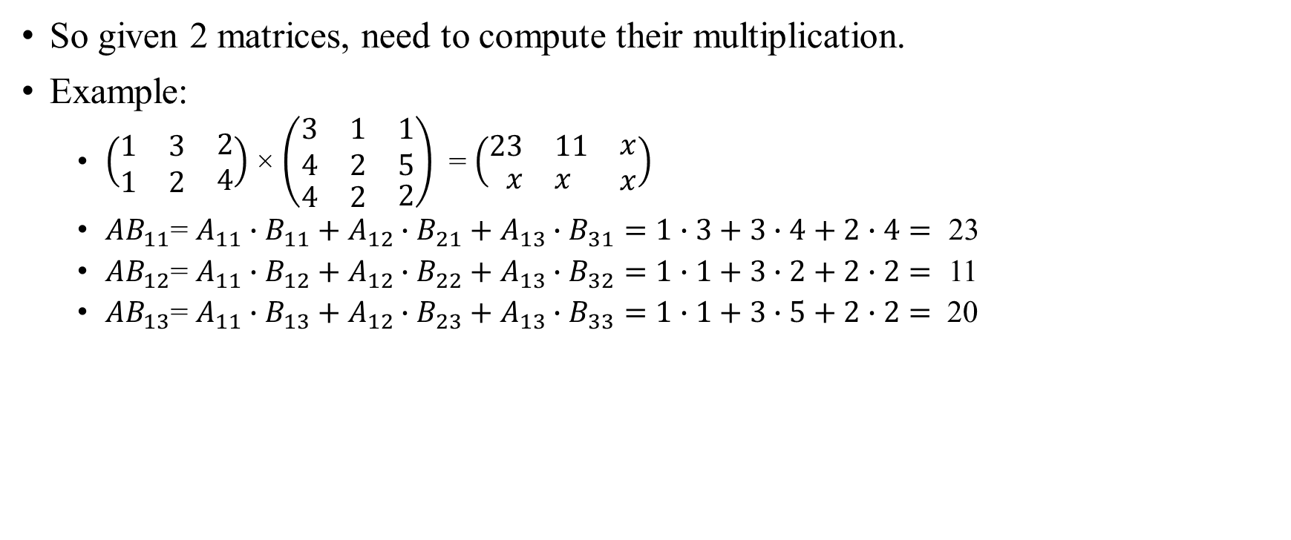
Matrix multiplication
So given 2 matrices, need to compute their multiplication.
Example:
$\left(\begin{matrix}\begin{matrix}1 & 3\end{matrix} & 2 \\ \begin{matrix}1 & 2\end{matrix} & 4\end{matrix}\right)$ × $\left(\begin{matrix}\begin{matrix}\begin{matrix}3 \\ 4\end{matrix} & \begin{matrix}1 \\ 2\end{matrix}\end{matrix} & \begin{matrix}1 \\ 5\end{matrix} \\ \begin{matrix}4 & 2\end{matrix} & 2\end{matrix}\right)$ = $\left(\begin{matrix}\begin{matrix}23 & 11\end{matrix} & x \\ \begin{matrix}x & x\end{matrix} & x\end{matrix}\right)$
${AB}_{11}$= $A_{11}∙B_{11}+A_{12}∙B_{21}+A_{13}∙B_{31}=1∙3+3∙4+2∙4=\text{ 23}$
${AB}_{12}$= $A_{11}∙B_{12}+A_{12}∙B_{22}+A_{13}∙B_{32}=1∙1+3∙2+2∙2=\text{ 11}$
${AB}_{13}$= $A_{11}∙B_{13}+A_{12}∙B_{23}+A_{13}∙B_{33}=1∙1+3∙5+2∙2=$ 20

Slide 8

Matrix multiplication
So given 2 matrices, need to compute their multiplication.
Example:
$\left(\begin{matrix}\begin{matrix}1 & 3\end{matrix} & 2 \\ \begin{matrix}1 & 2\end{matrix} & 4\end{matrix}\right)$ × $\left(\begin{matrix}\begin{matrix}\begin{matrix}3 \\ 4\end{matrix} & \begin{matrix}1 \\ 2\end{matrix}\end{matrix} & \begin{matrix}1 \\ 5\end{matrix} \\ \begin{matrix}4 & 2\end{matrix} & 2\end{matrix}\right)$ = $\left(\begin{matrix}\begin{matrix}23 & 11\end{matrix} & 20 \\ \begin{matrix}x & x\end{matrix} & x\end{matrix}\right)$
${AB}_{11}$= $A_{11}∙B_{11}+A_{12}∙B_{21}+A_{13}∙B_{31}=1∙3+3∙4+2∙4=\text{ 23}$
${AB}_{12}$= $A_{11}∙B_{12}+A_{12}∙B_{22}+A_{13}∙B_{32}=1∙1+3∙2+2∙2=\text{ 11}$
${AB}_{13}$= $A_{11}∙B_{13}+A_{12}∙B_{23}+A_{13}∙B_{33}=1∙1+3∙5+2∙2=\text{ 20}$

Slide 9
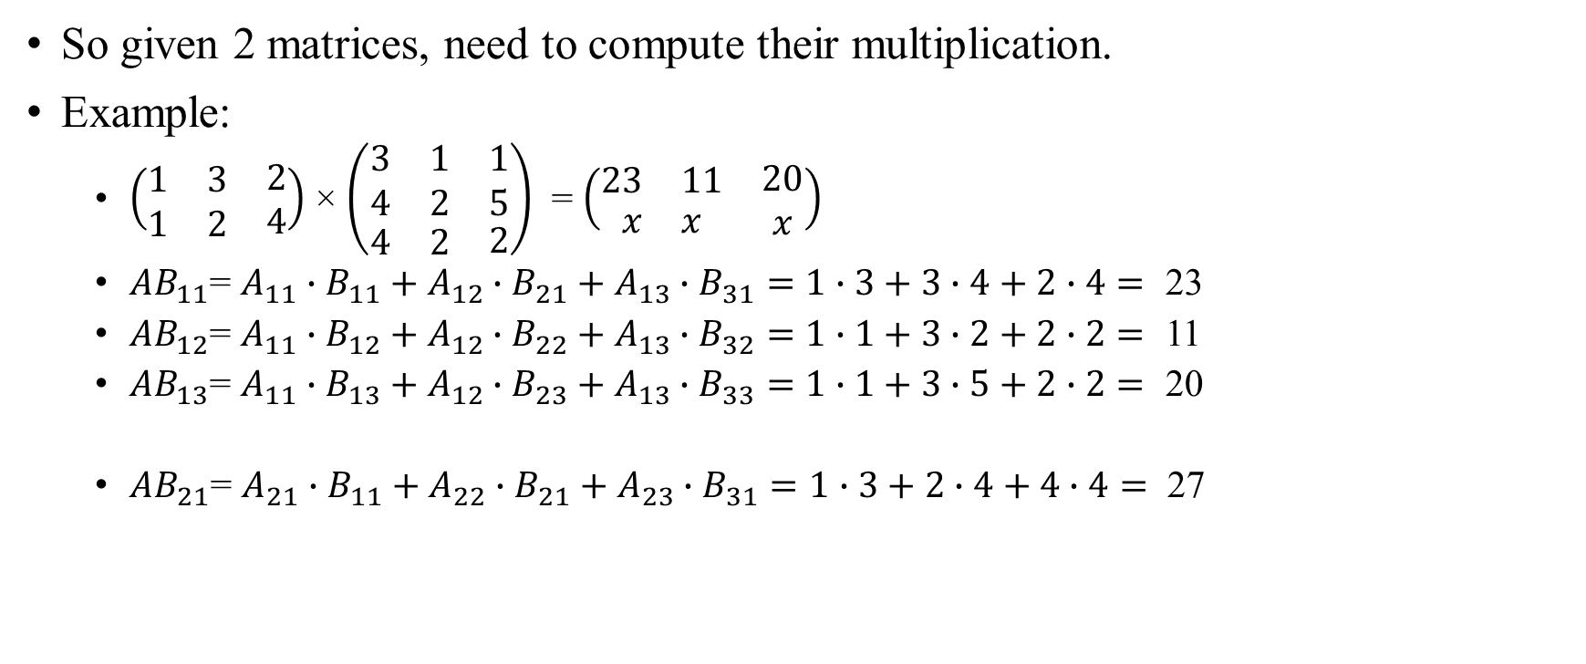
Matrix multiplication
So given 2 matrices, need to compute their multiplication.
Example:
$\left(\begin{matrix}\begin{matrix}1 & 3\end{matrix} & 2 \\ \begin{matrix}1 & 2\end{matrix} & 4\end{matrix}\right)$ × $\left(\begin{matrix}\begin{matrix}\begin{matrix}3 \\ 4\end{matrix} & \begin{matrix}1 \\ 2\end{matrix}\end{matrix} & \begin{matrix}1 \\ 5\end{matrix} \\ \begin{matrix}4 & 2\end{matrix} & 2\end{matrix}\right)$ = $\left(\begin{matrix}\begin{matrix}23 & 11\end{matrix} & 20 \\ \begin{matrix}x & x\end{matrix} & x\end{matrix}\right)$
${AB}_{11}$= $A_{11}∙B_{11}+A_{12}∙B_{21}+A_{13}∙B_{31}=1∙3+3∙4+2∙4=\text{ 23}$
${AB}_{12}$= $A_{11}∙B_{12}+A_{12}∙B_{22}+A_{13}∙B_{32}=1∙1+3∙2+2∙2=\text{ 11}$
${AB}_{13}$= $A_{11}∙B_{13}+A_{12}∙B_{23}+A_{13}∙B_{33}=1∙1+3∙5+2∙2=\text{ 20}$
${AB}_{21}$= $A_{21}∙B_{11}+A_{22}∙B_{21}+A_{23}∙B_{31}=1∙3+2∙4+4∙4=$ 27

Slide 10
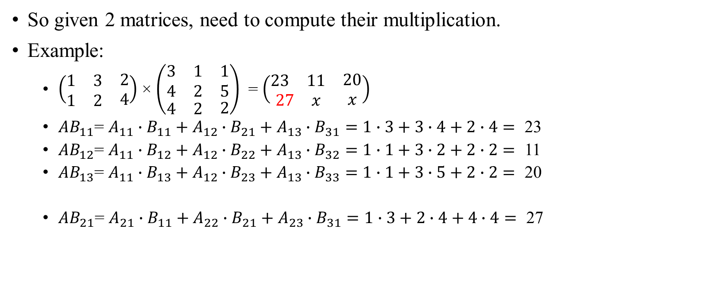
Matrix multiplication
So given 2 matrices, need to compute their multiplication.
Example:
$\left(\begin{matrix}\begin{matrix}1 & 3\end{matrix} & 2 \\ \begin{matrix}1 & 2\end{matrix} & 4\end{matrix}\right)$ × $\left(\begin{matrix}\begin{matrix}\begin{matrix}3 \\ 4\end{matrix} & \begin{matrix}1 \\ 2\end{matrix}\end{matrix} & \begin{matrix}1 \\ 5\end{matrix} \\ \begin{matrix}4 & 2\end{matrix} & 2\end{matrix}\right)$ = $\left(\begin{matrix}\begin{matrix}23 & 11\end{matrix} & 20 \\ \begin{matrix}27 & x\end{matrix} & x\end{matrix}\right)$
${AB}_{11}$= $A_{11}∙B_{11}+A_{12}∙B_{21}+A_{13}∙B_{31}=1∙3+3∙4+2∙4=\text{ 23}$
${AB}_{12}$= $A_{11}∙B_{12}+A_{12}∙B_{22}+A_{13}∙B_{32}=1∙1+3∙2+2∙2=\text{ 11}$
${AB}_{13}$= $A_{11}∙B_{13}+A_{12}∙B_{23}+A_{13}∙B_{33}=1∙1+3∙5+2∙2=\text{ 20}$
${AB}_{21}$= $A_{21}∙B_{11}+A_{22}∙B_{21}+A_{23}∙B_{31}=1∙3+2∙4+4∙4=\text{ 27}$

Slide 11
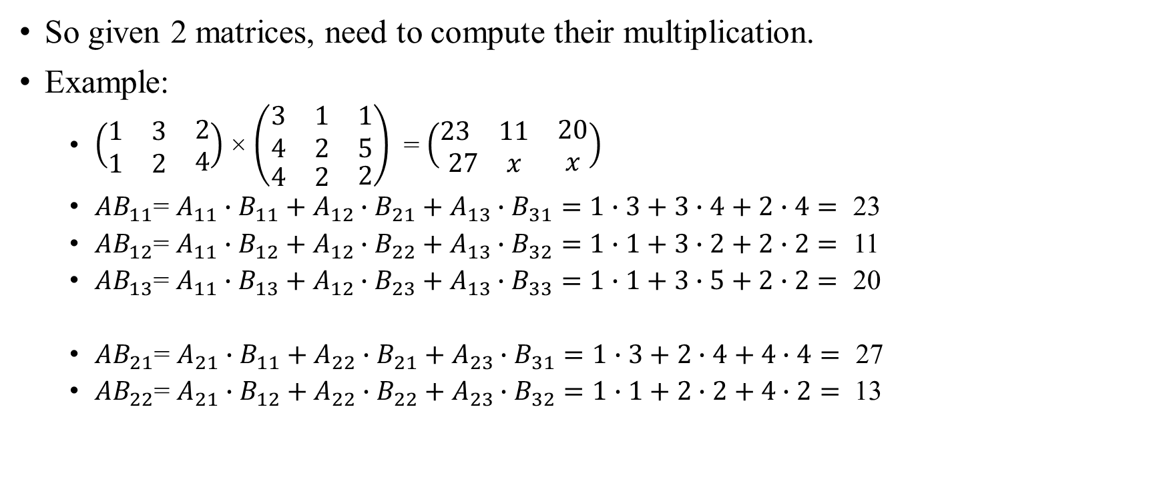
Matrix multiplication
So given 2 matrices, need to compute their multiplication.
Example:
$\left(\begin{matrix}\begin{matrix}1 & 3\end{matrix} & 2 \\ \begin{matrix}1 & 2\end{matrix} & 4\end{matrix}\right)$ × $\left(\begin{matrix}\begin{matrix}\begin{matrix}3 \\ 4\end{matrix} & \begin{matrix}1 \\ 2\end{matrix}\end{matrix} & \begin{matrix}1 \\ 5\end{matrix} \\ \begin{matrix}4 & 2\end{matrix} & 2\end{matrix}\right)$ = $\left(\begin{matrix}\begin{matrix}23 & 11\end{matrix} & 20 \\ \begin{matrix}27 & x\end{matrix} & x\end{matrix}\right)$
${AB}_{11}$= $A_{11}∙B_{11}+A_{12}∙B_{21}+A_{13}∙B_{31}=1∙3+3∙4+2∙4=\text{ 23}$
${AB}_{12}$= $A_{11}∙B_{12}+A_{12}∙B_{22}+A_{13}∙B_{32}=1∙1+3∙2+2∙2=\text{ 11}$
${AB}_{13}$= $A_{11}∙B_{13}+A_{12}∙B_{23}+A_{13}∙B_{33}=1∙1+3∙5+2∙2=\text{ 20}$
${AB}_{21}$= $A_{21}∙B_{11}+A_{22}∙B_{21}+A_{23}∙B_{31}=1∙3+2∙4+4∙4=\text{ 27}$
${AB}_{22}$= $A_{21}∙B_{12}+A_{22}∙B_{22}+A_{23}∙B_{32}=1∙1+2∙2+4∙2=$ 13

Slide 12
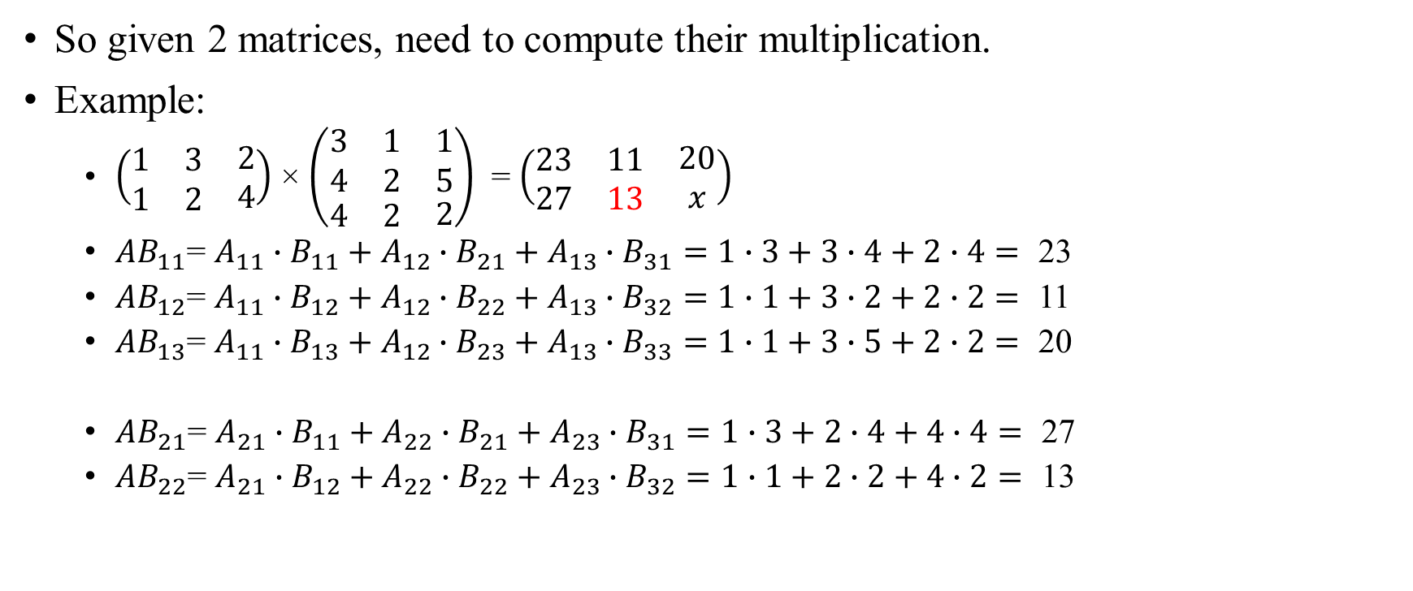
Matrix multiplication
So given 2 matrices, need to compute their multiplication.
Example:
$\left(\begin{matrix}\begin{matrix}1 & 3\end{matrix} & 2 \\ \begin{matrix}1 & 2\end{matrix} & 4\end{matrix}\right)$ × $\left(\begin{matrix}\begin{matrix}\begin{matrix}3 \\ 4\end{matrix} & \begin{matrix}1 \\ 2\end{matrix}\end{matrix} & \begin{matrix}1 \\ 5\end{matrix} \\ \begin{matrix}4 & 2\end{matrix} & 2\end{matrix}\right)$ = $\left(\begin{matrix}\begin{matrix}23 & 11\end{matrix} & 20 \\ \begin{matrix}27 & 13\end{matrix} & x\end{matrix}\right)$
${AB}_{11}$= $A_{11}∙B_{11}+A_{12}∙B_{21}+A_{13}∙B_{31}=1∙3+3∙4+2∙4=\text{ 23}$
${AB}_{12}$= $A_{11}∙B_{12}+A_{12}∙B_{22}+A_{13}∙B_{32}=1∙1+3∙2+2∙2=\text{ 11}$
${AB}_{13}$= $A_{11}∙B_{13}+A_{12}∙B_{23}+A_{13}∙B_{33}=1∙1+3∙5+2∙2=\text{ 20}$
${AB}_{21}$= $A_{21}∙B_{11}+A_{22}∙B_{21}+A_{23}∙B_{31}=1∙3+2∙4+4∙4=\text{ 27}$
${AB}_{22}$= $A_{21}∙B_{12}+A_{22}∙B_{22}+A_{23}∙B_{32}=1∙1+2∙2+4∙2=\text{ 13}$

Slide 13
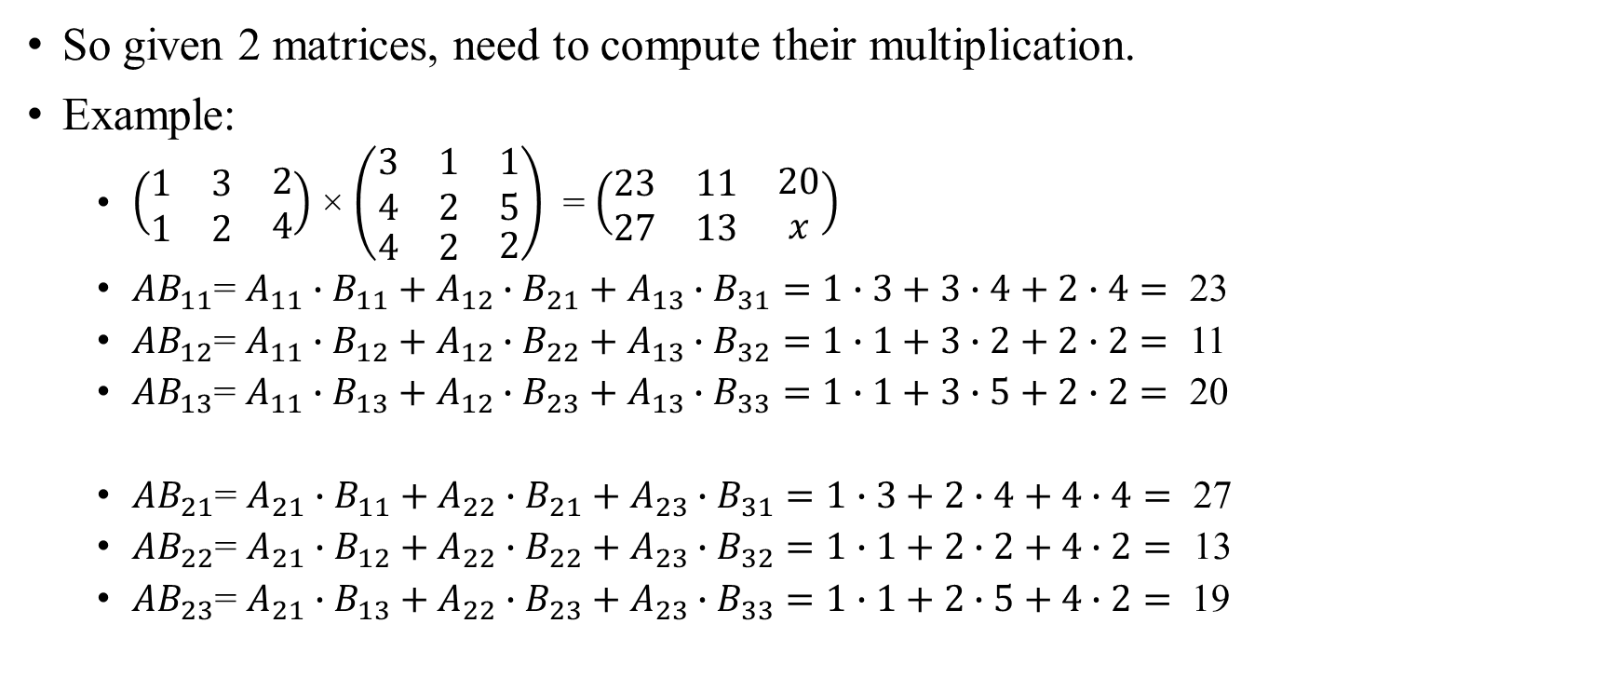
Matrix multiplication
So given 2 matrices, need to compute their multiplication.
Example:
$\left(\begin{matrix}\begin{matrix}1 & 3\end{matrix} & 2 \\ \begin{matrix}1 & 2\end{matrix} & 4\end{matrix}\right)$ × $\left(\begin{matrix}\begin{matrix}\begin{matrix}3 \\ 4\end{matrix} & \begin{matrix}1 \\ 2\end{matrix}\end{matrix} & \begin{matrix}1 \\ 5\end{matrix} \\ \begin{matrix}4 & 2\end{matrix} & 2\end{matrix}\right)$ = $\left(\begin{matrix}\begin{matrix}23 & 11\end{matrix} & 20 \\ \begin{matrix}27 & 13\end{matrix} & x\end{matrix}\right)$
${AB}_{11}$= $A_{11}∙B_{11}+A_{12}∙B_{21}+A_{13}∙B_{31}=1∙3+3∙4+2∙4=\text{ 23}$
${AB}_{12}$= $A_{11}∙B_{12}+A_{12}∙B_{22}+A_{13}∙B_{32}=1∙1+3∙2+2∙2=\text{ 11}$
${AB}_{13}$= $A_{11}∙B_{13}+A_{12}∙B_{23}+A_{13}∙B_{33}=1∙1+3∙5+2∙2=\text{ 20}$
${AB}_{21}$= $A_{21}∙B_{11}+A_{22}∙B_{21}+A_{23}∙B_{31}=1∙3+2∙4+4∙4=\text{ 27}$
${AB}_{22}$= $A_{21}∙B_{12}+A_{22}∙B_{22}+A_{23}∙B_{32}=1∙1+2∙2+4∙2=\text{ 13}$
${AB}_{23}$= $A_{21}∙B_{13}+A_{22}∙B_{23}+A_{23}∙B_{33}=1∙1+2∙5+4∙2=$ 19

Slide 14

Matrix multiplication
So given 2 matrices, need to compute their multiplication.
Example:
$\left(\begin{matrix}\begin{matrix}1 & 3\end{matrix} & 2 \\ \begin{matrix}1 & 2\end{matrix} & 4\end{matrix}\right)$ × $\left(\begin{matrix}\begin{matrix}\begin{matrix}3 \\ 4\end{matrix} & \begin{matrix}1 \\ 2\end{matrix}\end{matrix} & \begin{matrix}1 \\ 5\end{matrix} \\ \begin{matrix}4 & 2\end{matrix} & 2\end{matrix}\right)$ = $\left(\begin{matrix}\begin{matrix}23 & 11\end{matrix} & 20 \\ \begin{matrix}27 & 13\end{matrix} & 19\end{matrix}\right)$
${AB}_{11}$= $A_{11}∙B_{11}+A_{12}∙B_{21}+A_{13}∙B_{31}=1∙3+3∙4+2∙4=\text{ 23}$
${AB}_{12}$= $A_{11}∙B_{12}+A_{12}∙B_{22}+A_{13}∙B_{32}=1∙1+3∙2+2∙2=\text{ 11}$
${AB}_{13}$= $A_{11}∙B_{13}+A_{12}∙B_{23}+A_{13}∙B_{33}=1∙1+3∙5+2∙2=\text{ 20}$
${AB}_{21}$= $A_{21}∙B_{11}+A_{22}∙B_{21}+A_{23}∙B_{31}=1∙3+2∙4+4∙4=\text{ 27}$
${AB}_{22}$= $A_{21}∙B_{12}+A_{22}∙B_{22}+A_{23}∙B_{32}=1∙1+2∙2+4∙2=\text{ 13}$
${AB}_{23}$= $A_{21}∙B_{13}+A_{22}∙B_{23}+A_{23}∙B_{33}=1∙1+2∙5+4∙2=\text{ 19}$

Slide 15
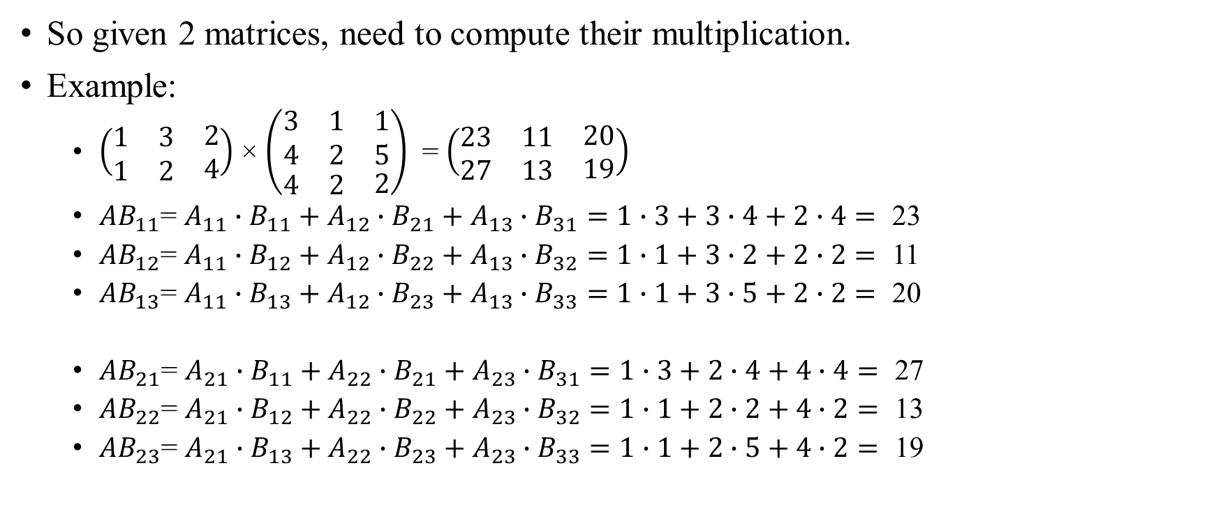
Matrix multiplication
So given 2 matrices, need to compute their multiplication.
Example:
$\left(\begin{matrix}\begin{matrix}1 & 3\end{matrix} & 2 \\ \begin{matrix}1 & 2\end{matrix} & 4\end{matrix}\right)$ × $\left(\begin{matrix}\begin{matrix}\begin{matrix}3 \\ 4\end{matrix} & \begin{matrix}1 \\ 2\end{matrix}\end{matrix} & \begin{matrix}1 \\ 5\end{matrix} \\ \begin{matrix}4 & 2\end{matrix} & 2\end{matrix}\right)$ = $\left(\begin{matrix}\begin{matrix}23 & 11\end{matrix} & 20 \\ \begin{matrix}27 & 13\end{matrix} & 19\end{matrix}\right)$
${AB}_{11}$= $A_{11}∙B_{11}+A_{12}∙B_{21}+A_{13}∙B_{31}=1∙3+3∙4+2∙4=\text{ 23}$
${AB}_{12}$= $A_{11}∙B_{12}+A_{12}∙B_{22}+A_{13}∙B_{32}=1∙1+3∙2+2∙2=\text{ 11}$
${AB}_{13}$= $A_{11}∙B_{13}+A_{12}∙B_{23}+A_{13}∙B_{33}=1∙1+3∙5+2∙2=\text{ 20}$
${AB}_{21}$= $A_{21}∙B_{11}+A_{22}∙B_{21}+A_{23}∙B_{31}=1∙3+2∙4+4∙4=\text{ 27}$
${AB}_{22}$= $A_{21}∙B_{12}+A_{22}∙B_{22}+A_{23}∙B_{32}=1∙1+2∙2+4∙2=\text{ 13}$
${AB}_{23}$= $A_{21}∙B_{13}+A_{22}∙B_{23}+A_{23}∙B_{33}=1∙1+2∙5+4∙2=\text{ 19}$

Slide 16
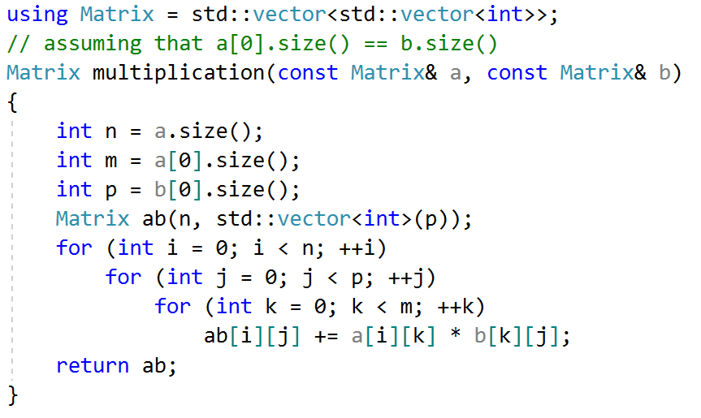

Matrix multiplication
Code is simple:
Complexity is $O(n∙m∙p)$

